Slide 1
CDK LSP Intern final demo
Megha Narayanan with AWS CDK CLI Team
Summer 2026

Slide 2
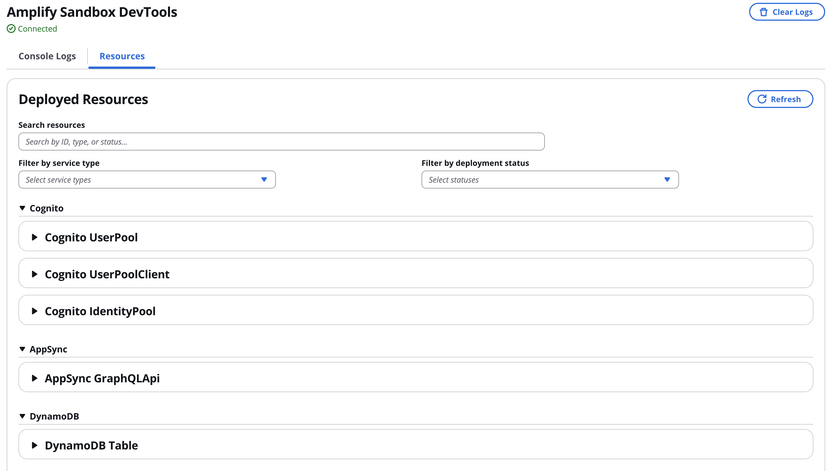
Background
Last summer, I worked with Amplify to build Amplify Sandbox DevTools, which streams real-time
sandbox console logs and lists all deployed backend resources grouped by service with search,
filtering, and deep links into the AWS Console.

Slide 3
Problem + Motivation
CDK makes infrastructure easy to write but hides what it builds: one new lambda.Function(...) silently creates several CloudFormation resources
Seeing what a construct produces is a manual slog: cdk synth, then dig through cdk.out/, then cross-reference tree.json, then jump to the CloudFormation console to trace a resource back to your code.
Policy violations surface too late (at synth/deploy) and land on generated resources with no easy link back to the source line that caused them.
The data already exists in the synthesized assembly, it's just not surfaced where developers (and AI agents) actually work.
“I've worked on some gnarly CDK deployments, so something like this would have saved me a fortune on hair dye” – CDK Dev Member

Slide 4
Where I Started + RFC
I started by designing in a public RFC, and getting a ton of feedback from the whole team.
Worked backwards first: wrote an RFC, an internal design doc, sketched the UI wireframes, wrote up docs on system design alternatives, all by week 2, before building.
The original vision: two tools sharing one offline core: cdk explore (a three-way linked view: source ↔ construct tree ↔ CloudFormation template) and cdk lsp (in-editor diagnostics, CodeLens, hover) with three-way linked navigation as the headline idea.
Responded to and refined through a lot of feedback and iteration and ~140 review comments across GitHub and Quip

Slide 5
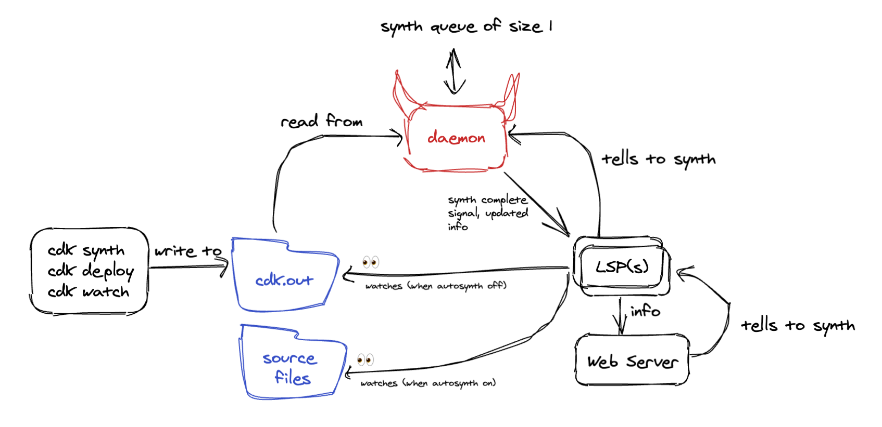
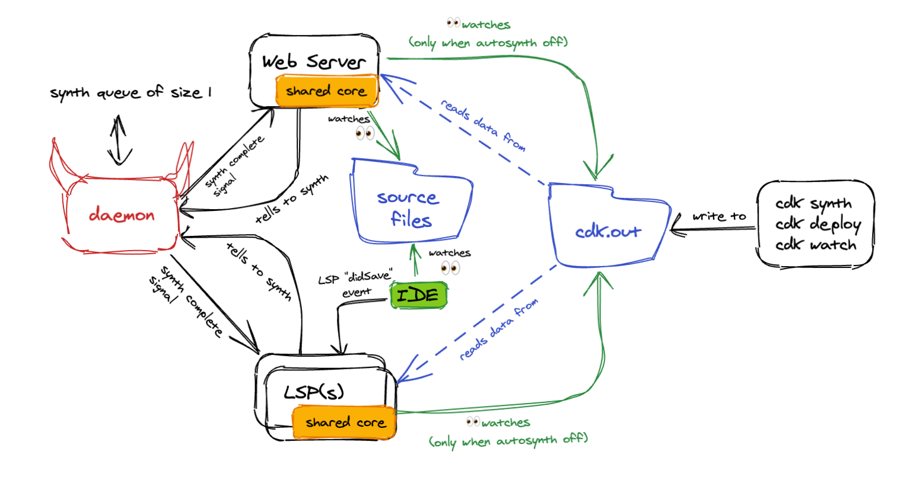
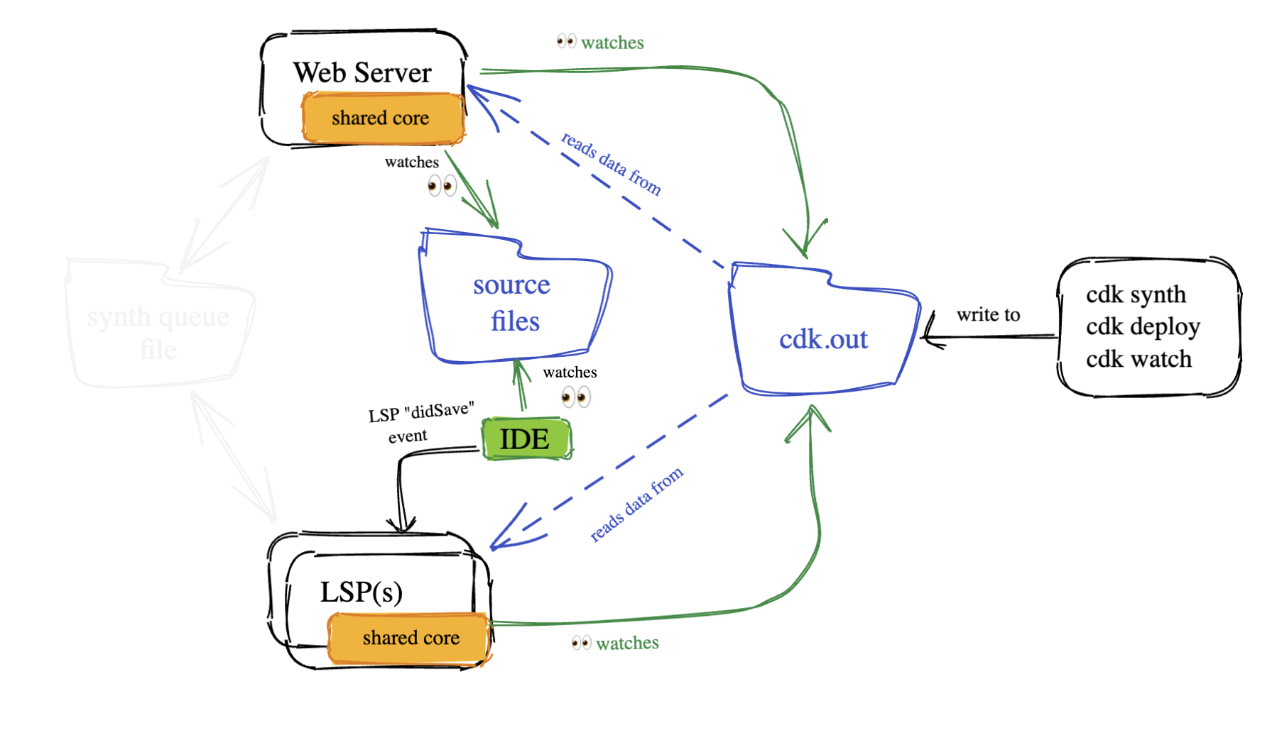
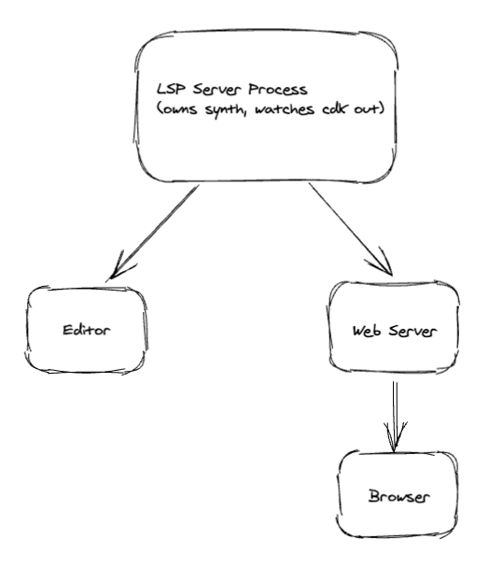
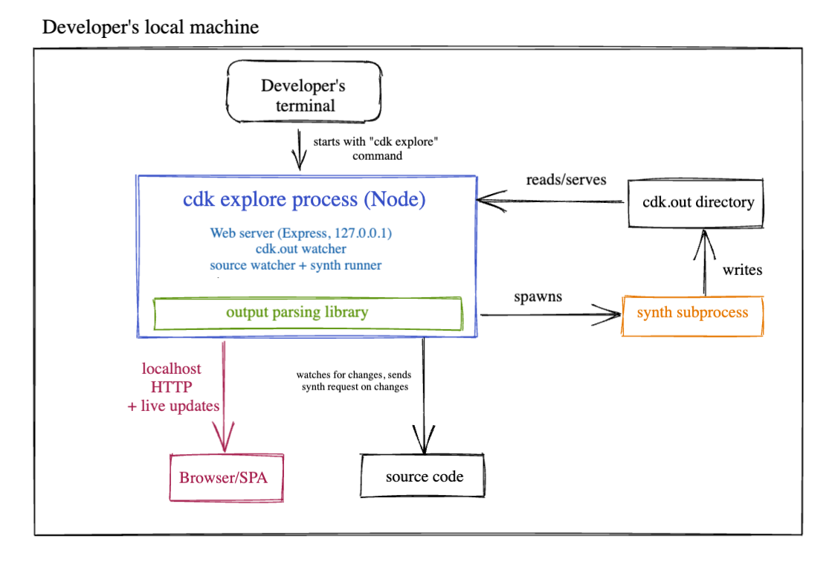
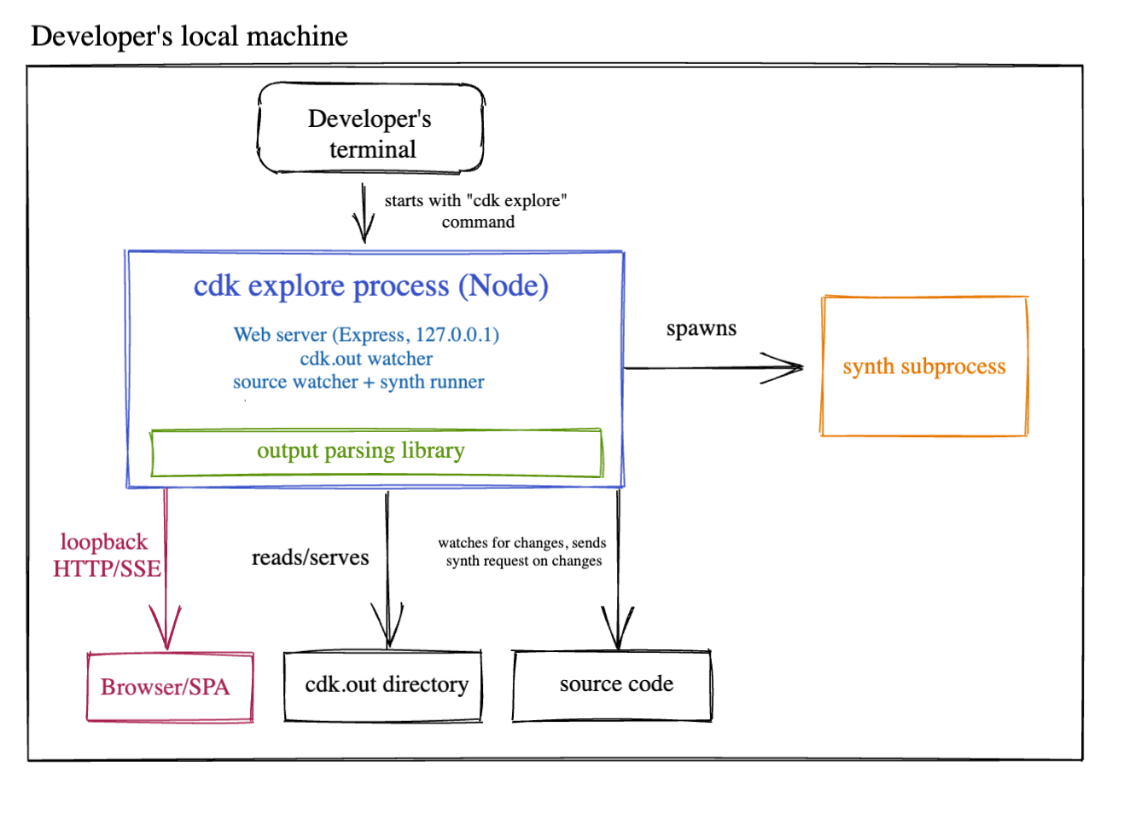
Lots of design evolution…

Slide 6
What I Achieved
Authored an accepted public RFC (aws-cdk-rfcs #923), took the feature through the open community design-review process and got it merged
Shipped cdk lsp (YAY !!!) the CDK Language Server I built ships in the publicly released aws-cdk CLI (v2.1132.0)
Built the Web Explorer: a three-way linked view connecting the construct tree ↔ CloudFormation template ↔ source code, with a live violations panel and auto-refresh on re-synth.
Drove cross-team adoption into the VS Code / JetBrains Toolkits: coordinated with the Toolkit team to open the integration PR surfacing the language server to end users in-editor.
When this merges, the LSP goes out to up to 5 million users in VSCode alone

Slide 7
LSP Demo
Diagnostics, hover, auto-synth, freshness and CodeLenses
Notes:
Hover
Diagnostics
Auto synth
Codelens
Template linking
VSCode toolkit linking
Staleness banners
Yaml/json
Three way nav
Violation filtering

Slide 8
Explorer Demo
Resource tree, freshness, staleness notifs,and three-way navigation

Slide 9
Bonus demo: Toolkit
Beefed up resource tree in the Toolkit Extension

Slide 10
What I Applied From Last Year
Looking back at my reflection from last year, I had three big areas that I said I would improve,
If I had an opportunity to do a similar project again
I would open smaller PRs, and start EARLIER
Last year, I opened 13 PRs with median size of 3,400 lines and my first PR didn't merge until Week 8.
This year I opened 40 PRs with median size of median 640 lines, and merged my first PR in Week 3.
I would set a firm goal for when I would stop implementing new features and focus on refining
Last year, I kept implementing up to my last week.
This year, I scheduled a PRE-demo for Week 10, which was my personal deadline for new features,
where I showed off my product and got feedback from our team to refine my existing design rather than continuing to add more functionality
I would be proactive with AppSec to get my project out of a feature branch

Slide 11
What Challenged Me + What I Learned
With such an open ended project, I ended up making a lot of design decisions, some which panned out on my first try, and some which didn’t
Picking a path forward when sometimes there isn’t a nice, clear solution
The problem (and related features) were dynamic, meant my roadmap updated as I went and I often had to juggle many concurrent lines of development
I always underestimate how long appsec (and generally waiting on other teams) will take
Learned how to take ownership while still acknowledging feedback
Examples: Dropping the VSCode webview, the synth daemon, dropping synth from web explorer
Learned a TON about system design
Learned about security considerations
Like threat modelling + evaluating dependencies, etc.
Learned how to coordinate with my team on multiple moving fronts
Validation work, JSII work, Toolkit work

Slide 12
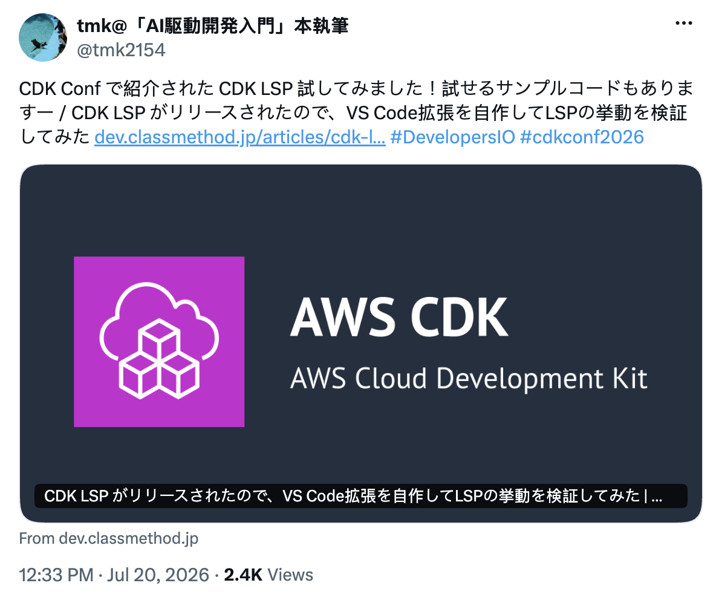
Misc. Internship Highlights + Lowlights
Got to meet w/ Principal Engineer Kamiel Wanrooij (Thank you Mark!)
Got banned from Github ☺
Got to coordinate with people on 3+ other teams
Got 8 PR’s approved by Rico with 0 comments!
Got Claude to curse at me over a frontend bug
Got to merge a (minor) upstream improvement
Got mentioned in a Japanese CDK Blog!

Slide 13
Looks awesome for human developers, but what about agents?
Results of my preliminary LSP Agent study

Slide 14
So does the LSP make agents faster?
Detailed report:
Metrics: agent turns and cost, at equal accuracy.
THE TASKS (all ask about facts that only exist after synthesis):
explain report a construct's synthesized logical ID and resource type
verify is versioning actually on in the synthesized template? yes/no + logical ID
resolved what default billing/throughput does this table get? (a default not in source)
boundary tasks (to find where it does not help): fix, debug, audit, write
Arm | What the agent gets
LSP (ours) | CDK language server; hover returns synthesized logical ID, type, resolved properties
warm grep | No LSP, fresh template on disk to grep (same on-disk state = fair comparison)
cold synth | No LSP, no template; must run cdk synth first

Slide 15
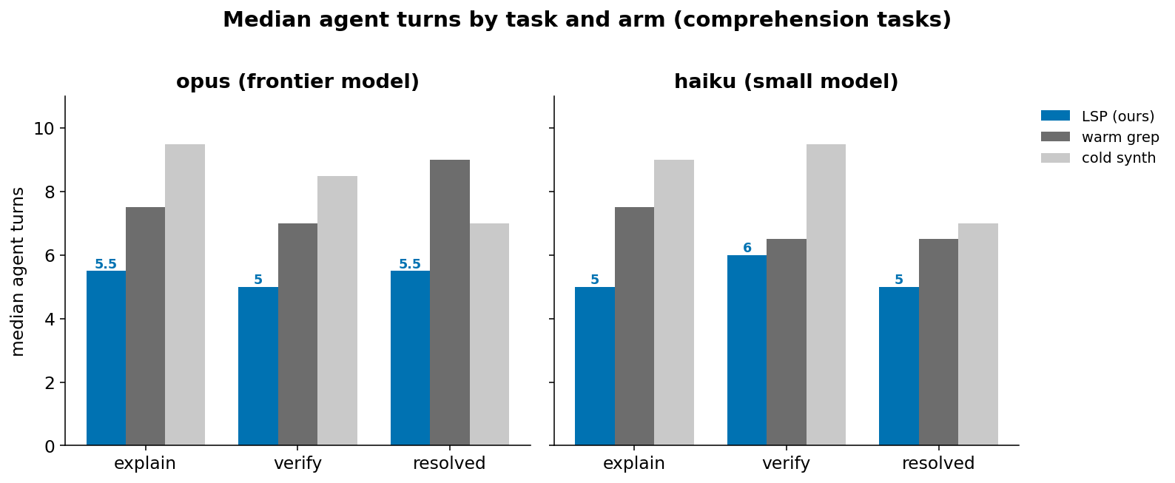
Findings
Fewer turns: roughly 25 to 40% fewer agent turns on comprehension, both models, at 100% accuracy.
Beats even warm grep: on verify, the LSP is cheaper than a baseline that already had the synthesized template on disk
Task | Model | LSP | warm grep | Result
verify | opus | 5t / $0.18 | 7t / $0.25 | −29% turns, −27% cost
verify | haiku | 6t / $0.23 | 6.5t / $0.40 | −8% turns, −42% cost
explain | opus | 5.5t / $0.20 | 7.5t / $0.24 | −27% turns, −17% cost
explain | haiku | 5t / $0.20 | 7.5t / $0.34 | −33% turns, −41% cost

Slide 16
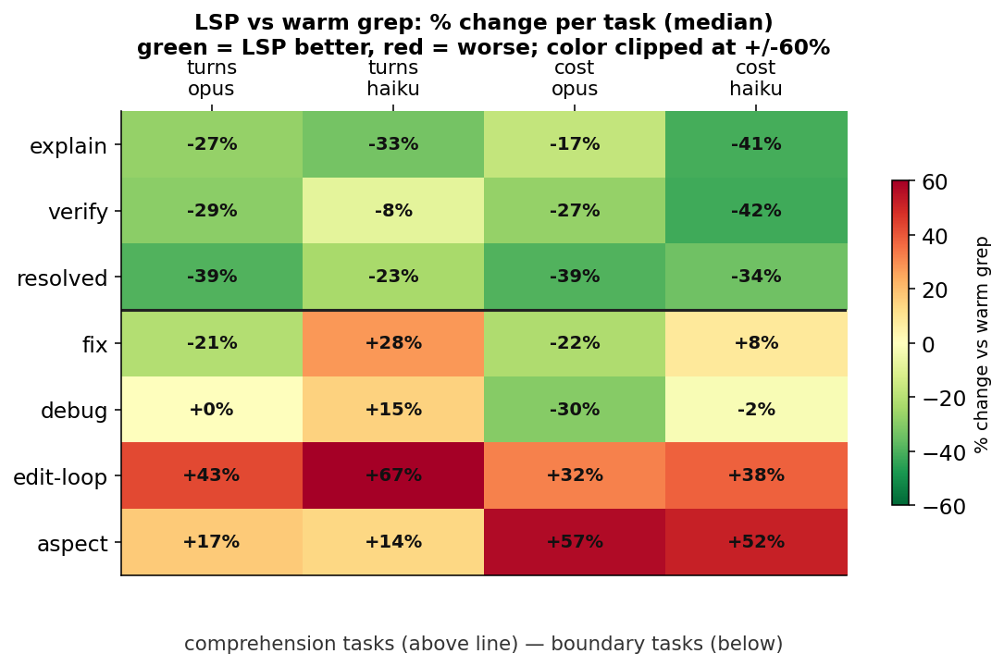
Task Boundary
Where the LSP is NOT helpful
Task | What it asks | Why the LSP loses
fix | verify from synth, edit source, report ID | the edit dominates; model dependent
audit | list every logical ID in a stack | one grep beats many per-construct hovers
write | predict a not-yet-created construct's ID | hover only sees the already-synthesized view
edit-loop | edit then re-query, repeatedly | Synth latency is an issue; serves stale after edit
aspect | a value an Aspect changed at synth | baselines read the template too and won in fewer turns

Slide 17
The Anthropic-side blocker
Claude Code allows only 1 LSP per file extension: first-registered wins, the loser never starts.
Symptom (CDK LSP + TypeScript server both on .ts, CDK wins):
hover ✓
goToDefinition ✗
findReferences ✗ → you lose TS navigation
Agent-path only; real IDEs merge servers and coexist fine
Upstream: no fix in sight
#27692 (multi-server + merge — what we'd need): closed, not planned
#64422 (silent first-wins overwrite): closed, not planned
#75881 (only open one): failure-isolation only, doesn't enable co-serving
Side note: Claude Code mass-closes issues (they have 13k+ open right now), so "not planned" is not necessarily a forever not-happening

Slide 18
What’s left and What’s next?
Pending items and features I would love to see in the future

Slide 19
Open items + handoff
Knowledge transfer document (and todos)
Merge ’cdk explore’ to main
Merge LSP + Construct Tree to VSCode Toolkit Extension
Merge LSP to JetBrains
Improve Claude integration

Slide 20
Telemetry
Goal is to collect data on 1) how the LSP is being used 2) if it is working as it should
Proposal: https://quip-amazon.com/suPWAbD9aKlx
Collects only counts, durations, and small labels, around four questions:
Adoption: who uses it, which routes, editors and languages
Performance: is it fast (synth latency)
Reliability: is it working or failing quietly
Coverage: do constructs link to source and violations land right

Slide 21
THANK YOU!!!!

